Slide 1
GRADUATION SIMPLIFIER Elaboration: Iteration III
ICS 370 FALL 2020
By: Bradley Taylor, Rene Ntumnui, David Qual

Slide 2

Introduction
In this Elaboration phase, we are going to show with diagrams the system concepts, vision, system boundary and scope of the system.
These diagrams will demonstrate the interactions between users and the system we developed.
Our prototype will demonstrate 100% or our use cases.
We will also cover all other factors considered in building our systems.

Slide 3
Use Cases
Users/Actors | Use Cases/Functionalities
Student | Login Select Major Upload Transcript/Dars Report View Results Print Results Download Results
Administrator | Login Upload CSV File

Slide 4

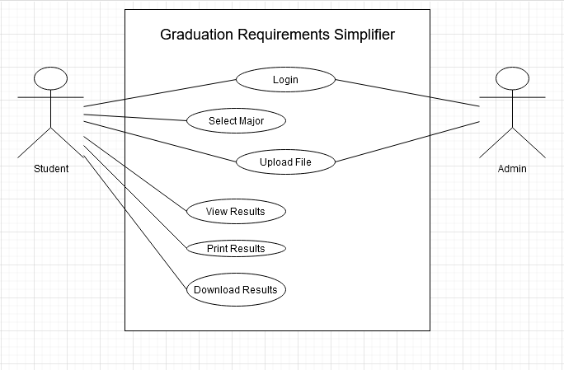

Slide 5
Domain Model
Our domain model is going to show how our system functions.
The model does not go into dept about the components of our software.
Our model is also going to show the associations between our conceptual classes.
It also show the type of relationship between classes whether it be one-to-one or one-many, or many-many.

Slide 6

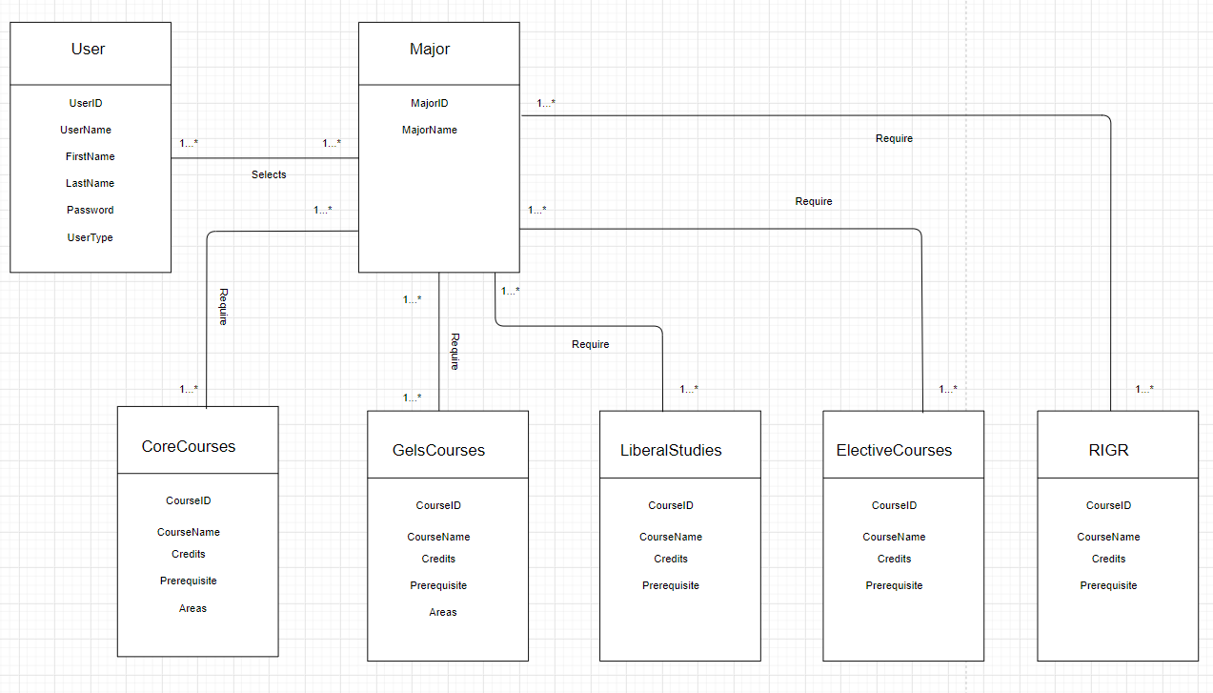
Domain Model

Slide 7
System Sequence Diagram
This diagram is going to clarify the different input and output events related to our system.
Our system sequence diagram shows how actors interact with the system.
It shows how external actors use the system .
Our diagram show the order in which actions and events occur.

Slide 8
System Sequence Diagram Cont.
This system sequence diagram demonstrates how the system response to actions taken by both internal and external actors.
The methods our database uses to execute the commands given by the actors are not listed because our systems is a closed box.
This diagram is strictly derived from the use cases identified in our inception phase.

Slide 9
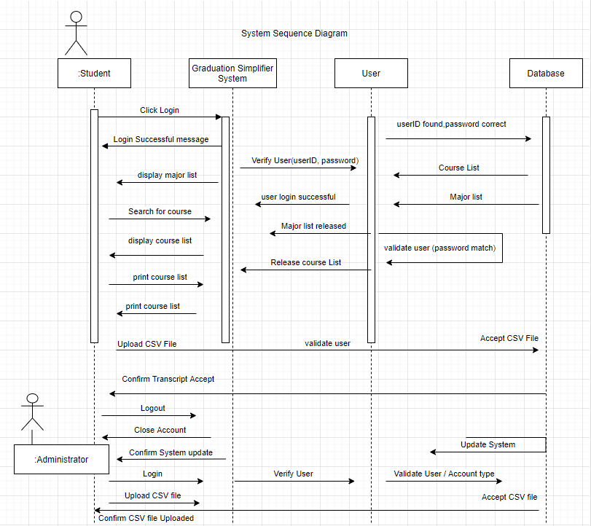
System Sequence Diagram

Slide 10

Class Diagram
This diagram consist of a set of classes and the relationships between those classes.
It show the structures of classifiers in our system.
This diagram also provides basic notations for other structure diagrams that are going to be presented in our system.

Slide 11
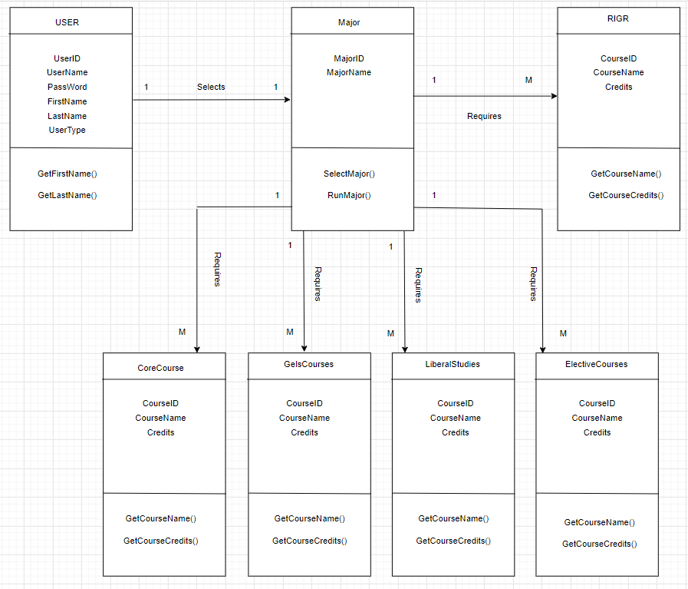
Class Diagram

Slide 12
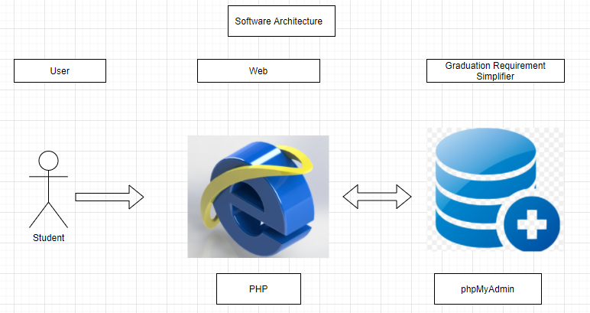

Slide 13
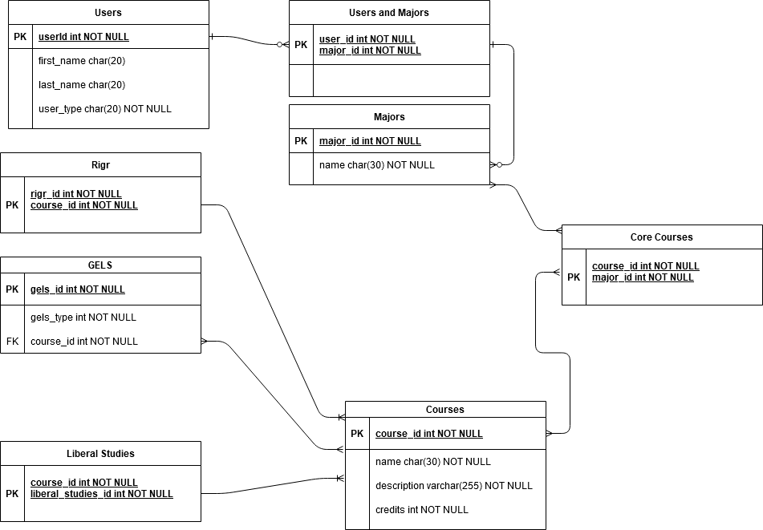
Data Model

Slide 14
GoF Design Patterns
We have several types of course requirements that are classes with different functionalities.
Composite Patterns allow each object to function with the same interface.
These functions allows clients to treat objects and their compositions the same way.

Slide 15

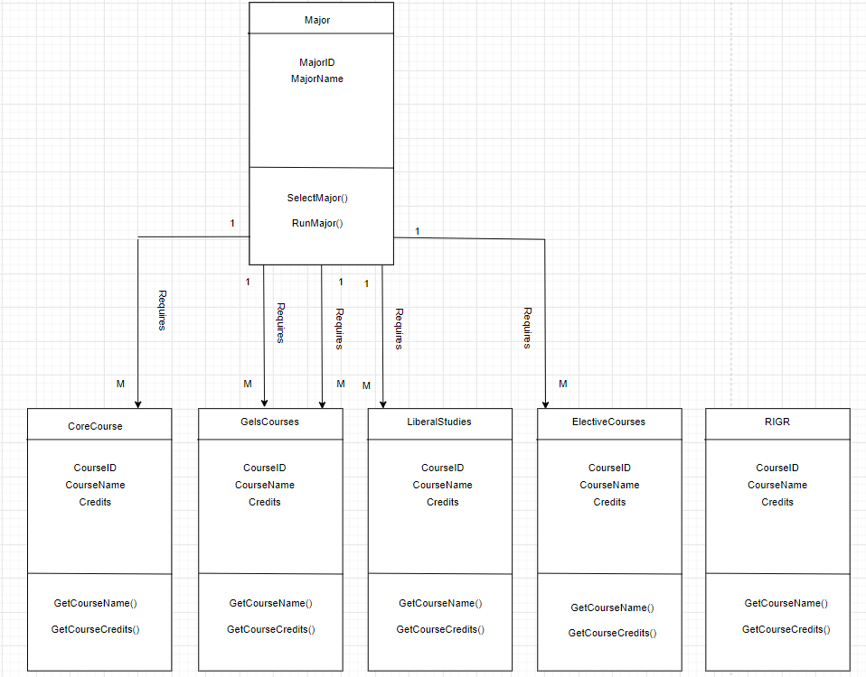
Composite Pattern

Slide 16
High Cohesion
High cohesion is an evaluative pattern that attempts to keep objects appropriately focused, manageable and understandable.
High cohesion is generally used in support of low coupling.
Cohesion is a measure of how the methods of a class, or a module are meaningfully strongly related.
It shows how focused it is in providing well-defined purpose to the system.
We have used this method to show the efficiency of our class methods.

Slide 17
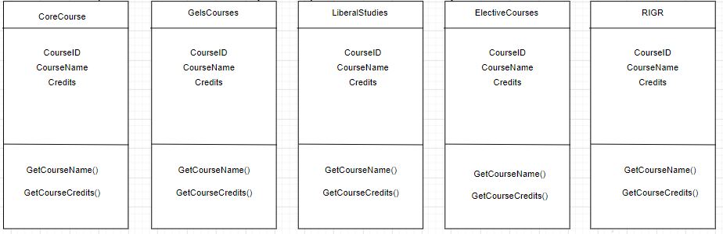
High Cohesion

Slide 18
Software Architecture
Here are a list or architecture problems within our system.
Moving from python to a web app
Generating and retrieving data
Building databases
Missing logic to build the fastest approach to completing a major
Missing logic to ingest files
Missing logic to handle searching
Missing logic to handle logging in

Slide 19
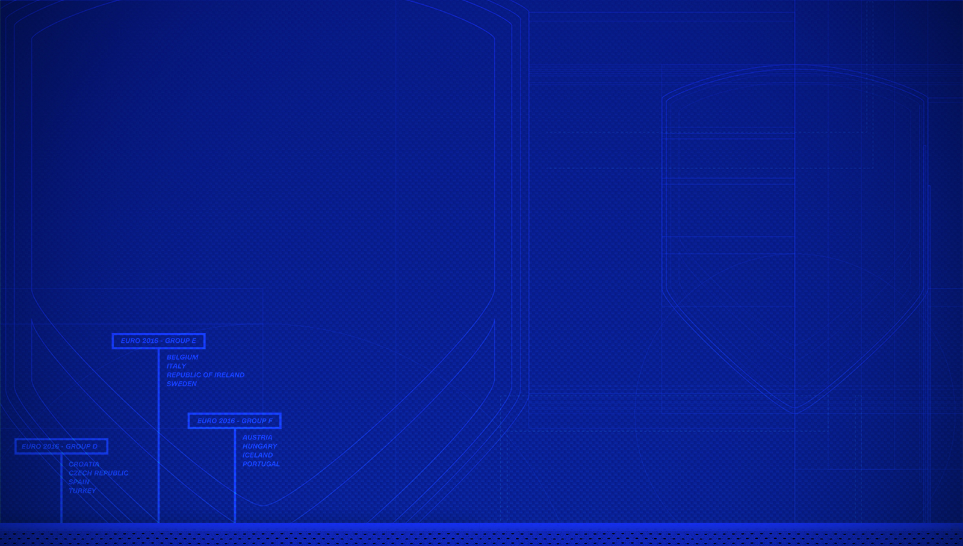
Architecture Resolutions
Some of our architecture issues have been resolved.
Moving to from python to a web app has been successful, the UI has been fully migrated and there is now more data than was in the original prototype. This should be considered complete.
Generating and retrieving data was in flight and will be an ongoing issue. Through the usage of existing helper code the generation of relevant data for the databases can be harvested and cleaned.
Building the databases is an ongoing issue that could not be completed by the time of the first presentation.

Slide 20
Resolved Issues
The following issues were resolved as we progressed.
File ingestion
Search logic
Logging in to the system is a work in progress
Fastest possible path to Major completion

Slide 21
Student
The student will be the primary actor in our system.
The student will have to be able to login to access the interface of the program. Upon gaining access to the interface, the student will need access to several program features.
These features include the ability to select a major course of study, upload a transcript or Dars Report, run the program, and access the results. Additionally, the student will need to view, download, or print the results.
Administrator
There will be a system administrator that needs to interact with the system.
The administrator will need to be able to login to access the administrative features of the program.
Upon gaining access to the administrator interface, the instructor will need the ability to configure and maintain program majors and requirements.

Slide 22
Hardware and Software Requirement
For development
Realistically web development can be done with nearly any device with a text editor, so this greatly reduces the need for any high spec device or development software.
There is also a need for a database manager. We use MySQL as a database so the system would need to be able to use that.
The requirements are rather low, so an i3, 4gb of ram and 128gb hard drive (preferably an SSD) are the minimum requirements. You would also need to install the MySQL software.
For users
This would be a website with the only need being a modern browser to facilitate access to most websites.
The website would be accessible by mobile devices, but the best experience would be from a computer.

Slide 23
Stakeholders and Requirement
Our software is design to serve Metropolitan State University students. It will cover a variety of areas within the school. There is an exploration project to assess the potential market value of this program.
The factors we will look into are:
Business case
Technical
Financial
Economical
Political

Slide 24
Business Case and Project Vision
The average bachelor’s degree requires 120 college credits, yet the average recipient completes 134 credits before graduating.
Students change schools or major and understanding what they need is crucial.
Degree audits can be very confusing to read which further complicates the life of a student.
This application is accessible online and it is easy to read.
Students won’t need to schedule appointments or sit down with advisors.

Slide 25
Technical Factors
We assessed the technical factors aspect of this system from two different points of view.
The first part was project development and infrastructure. We learned that there are freeware available for us to use and in some cases, we will use low-cost subscription SaaS products.
The second viewpoint was the technological accessibility of all potential end users.
We asses that all students at Metro State have access to a laptop or desktop computer either through the school or personally.
Finally, there will be no additional hardware requirement to what is already available and there will be no cost associated with end users.

Slide 26
Financial Factors
Software development often come with a huge price tag because of technical and operational expenses.
We are going to eliminate these expenses because we already have the necessary hardware available.
Operationally, our staff consists of three individuals working together to meet this goal.
There is no movement from one place to the other which saves money and its convenient.
We do expect there to be minimal expenses related to software which may come in the form of licensing or subscription fees pertaining to the hosting of our solution.

Slide 27
Economic Factors
The economic section explores the ability of the solution to break even or potentially become profitable in the future.
We anticipate a considerable incubation period for this software to become widely used and appreciated.
Graduation requirements are not always considered daily but rather towards the end of each semester.
This factor contributes greatly to the lengthy time incubation.
Further exploration will be done to determine a break-even period because our project needs several semesters to elapse and students and advisors use and appreciate this powerful tool.

Slide 28
Political Factors
From the previous section, we stated that a lengthy time is required before the system is widely used and our research on political feasibility helped us conclude that assessment.
Non of the factors considered were harmful significantly or insurmountable.
Our project is designed to help students and advisors. We expect the latter to involve political implications.
The concept of improving the current system implies that a weakness or deficiency exists.
Previous experiences show that attempts made to improve a process or procedure within any organization faces backlash from current stakeholders.
We anticipate this system to be significantly beneficial to overcome those push back.

Slide 29

Market Factors
Our completed project will have great potential within Metro State.
We envision that students will find the solution to be intuitive and easy to use.
The system will negate the need for countless appointments with advisors and will provide a peace of mind.
Advisors will also benefit greatly.
Informed students will free up advisors'’ time and allow them to perform other essential duties and manage their caseloads more efficiently.
This application will improve students experience and advisors efficiency thus it will be coveted throughout the industry.
This factor greatly mitigates the lengthy break-even period previously discussed.

Slide 30
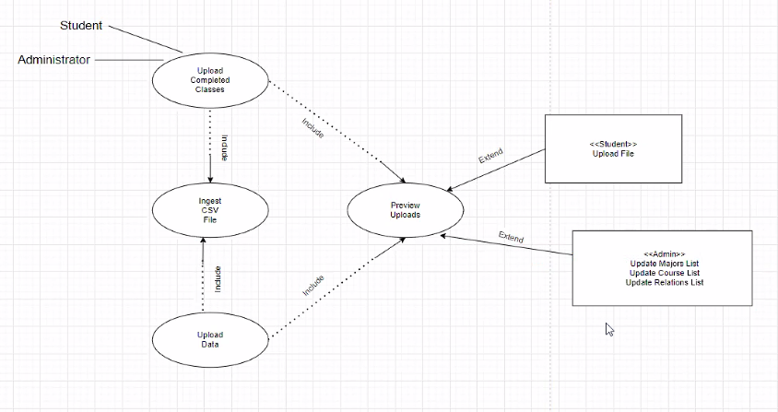
Activity Diagram

Slide 31
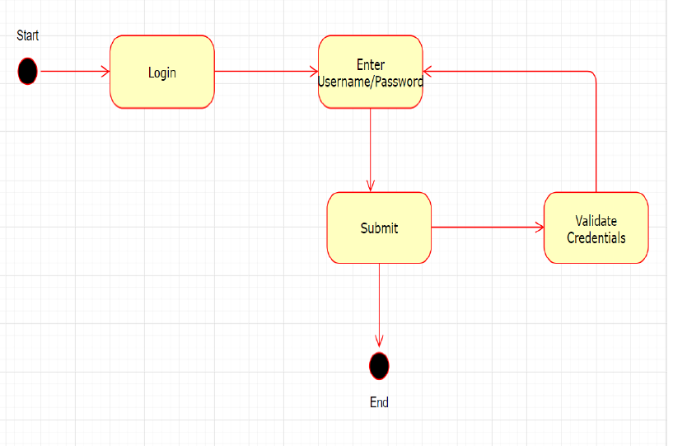
Activity Diagram
Access Account
Logging to account
If valid user/password, access to page granted. If not, prompt to register or re-enter credentials.
End

Slide 32
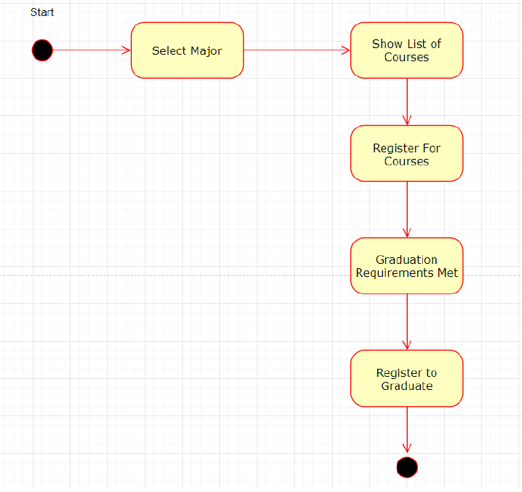
Activity Diagram
Student Select Major
Select Major
Show lists of required courses
Register for courses
Once courses are completed, Graduation requirements met.
Register to Graduate.
End.

Slide 33
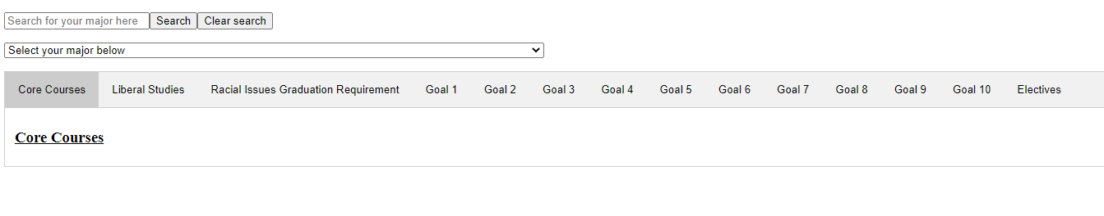
System Prototype

Slide 34
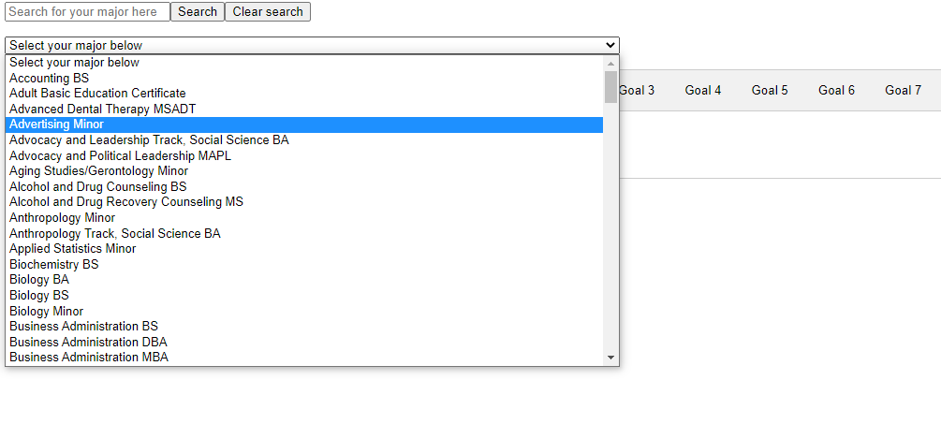
Prototype

Slide 35
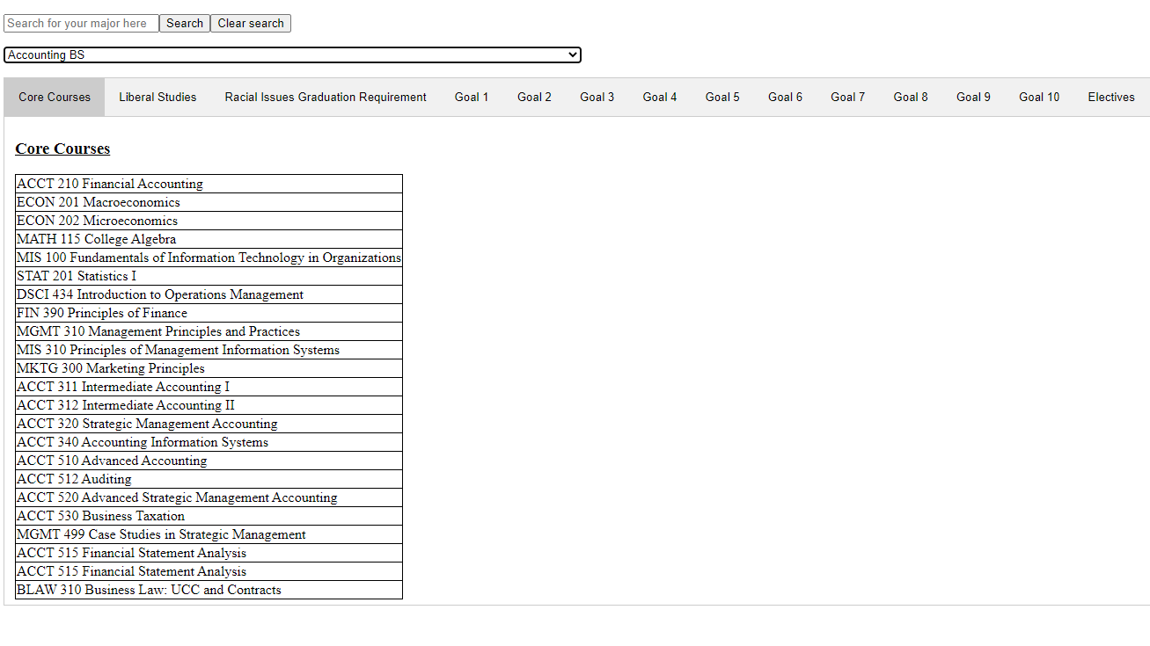
Prototype

Slide 36
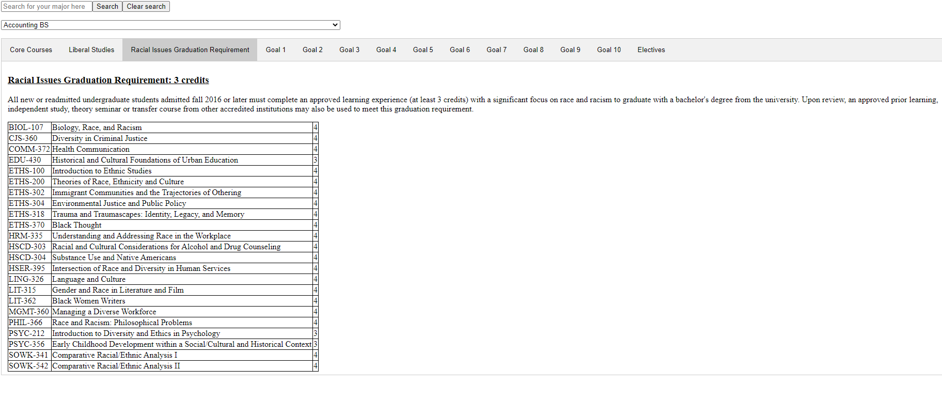
Prototype

Slide 37
Thank You.

